Slide 1
Machine Learning for CV
Deep learning classification
Group 5:
Miruna-Diana Jarda
Gunjan Paul
Diana Tat

Slide 2
Introduction
In this week, we aim to assess an MLP's image classification capabilities, focusing on inner embeddings.
The initial step involves training the MLP to classify entire images into eight classes, acknowledging the lack of specific local information. Subsequently, we explore using the last MLP layer as a classifier (e.g., SVM, RF) to validate information derived from inner embeddings. Experimentation with MLP architecture variations is encouraged.
Another task involves dividing images into patches, training an MLP, and aggregating classification vectors. An innovative approach suggests using embeddings from the previous task as descriptors, applying the Bag-of-Words framework for improved performance.
Although results may not match the previous week, we will monitor carefully of learning curves.
Lastly, we investigate whether inner embeddings preceding the classification layer effectively represent complex stimulus features in MLPs.

Slide 3
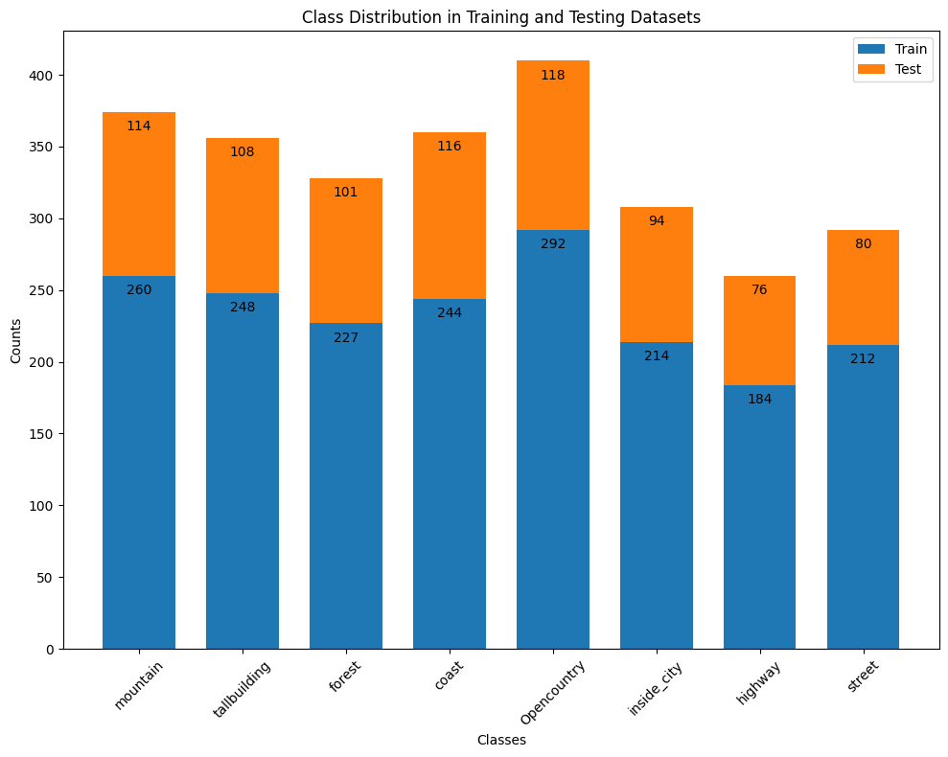
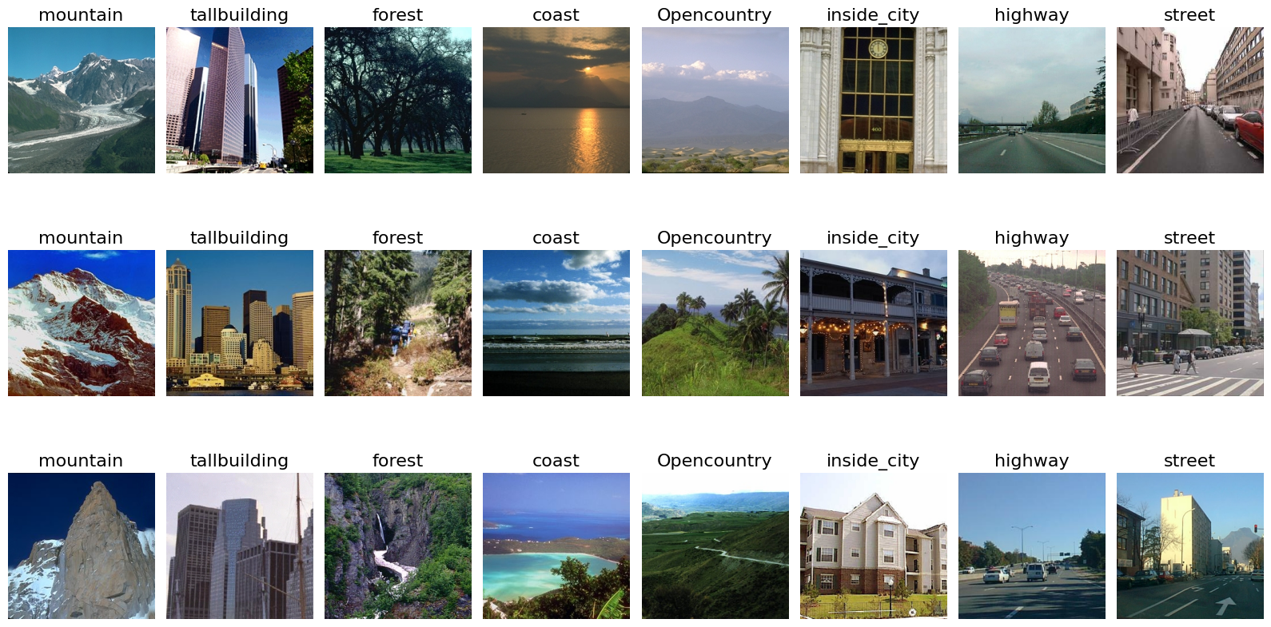
Dataset
Exploratory Data Analysis
Fig 1: Dataset is fairly balanced across different classes in both training and testing sets
Fig 2: Random sample image of each class

Slide 4
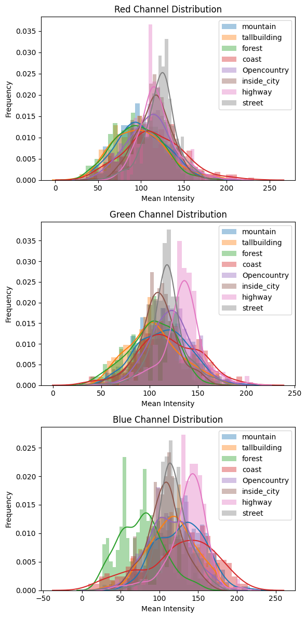
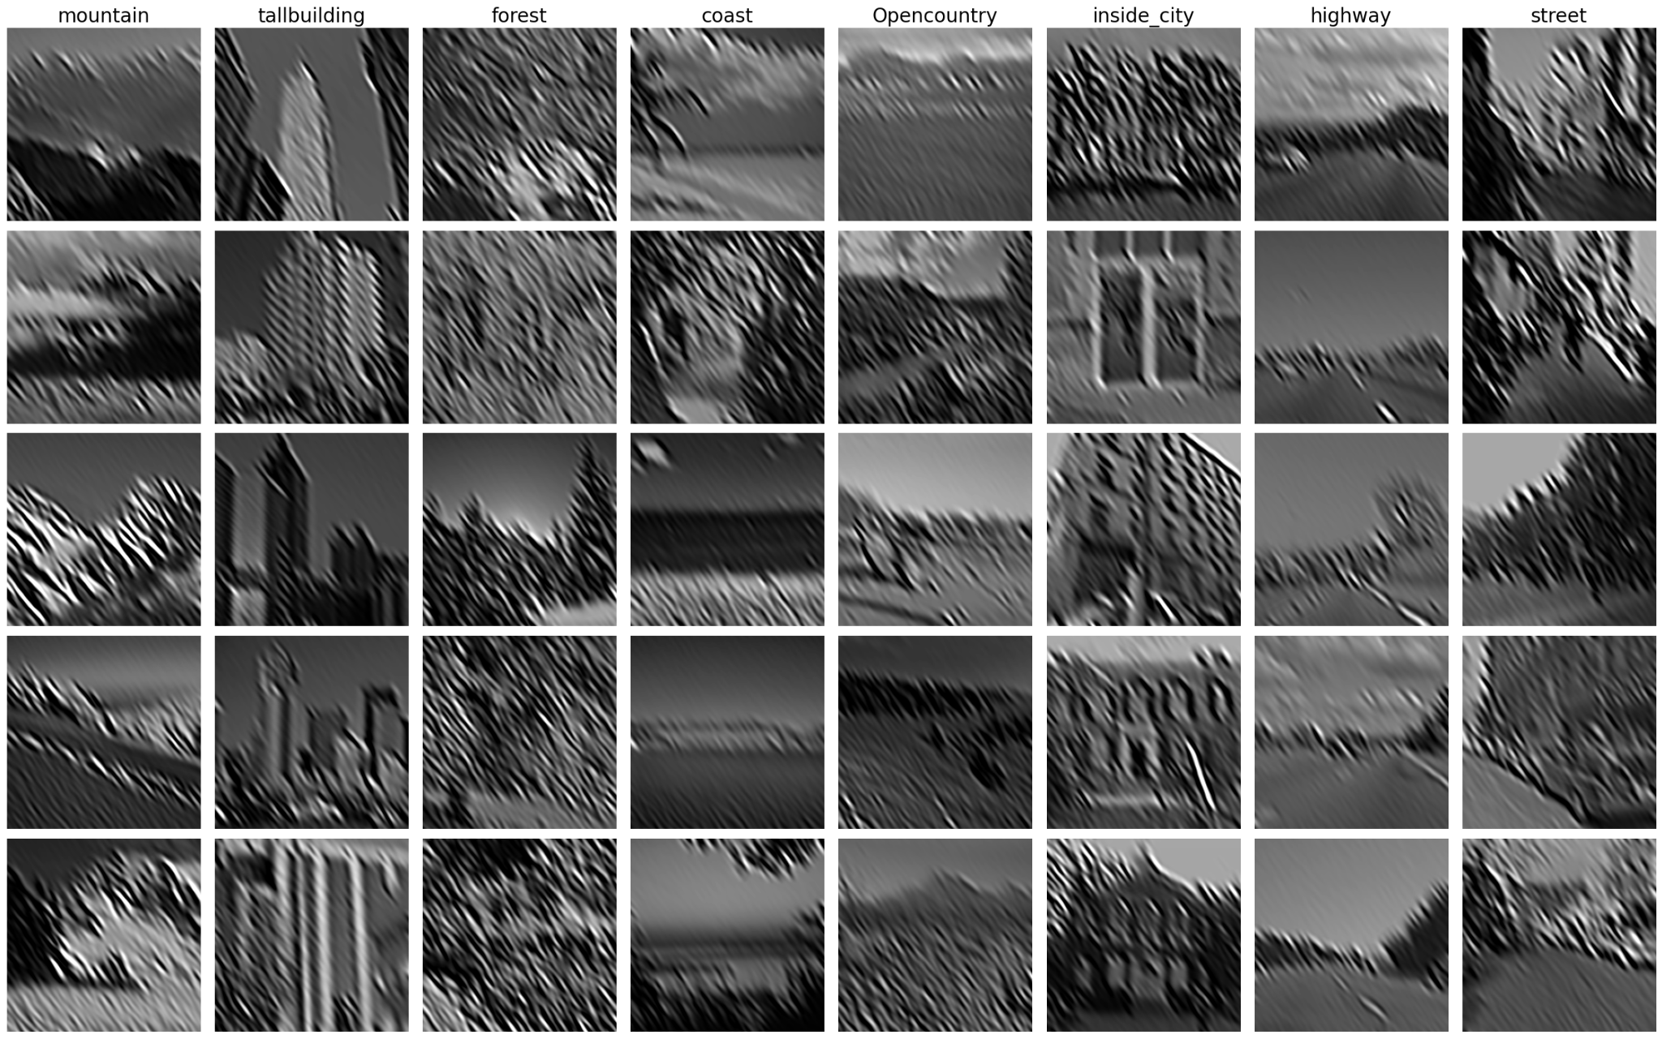
Dataset
Exploratory Data Analysis
Gabor filter visualization assists in identifying key textural features and patterns in images, providing insights for optimizing CNN architectures and preprocessing strategies to enhance model accuracy.
Fig 4: Visualizing Gabor Filter Responses Across Different Classes
Fig 3: RGB Channel Intensity Distributions Across Classes

Slide 5
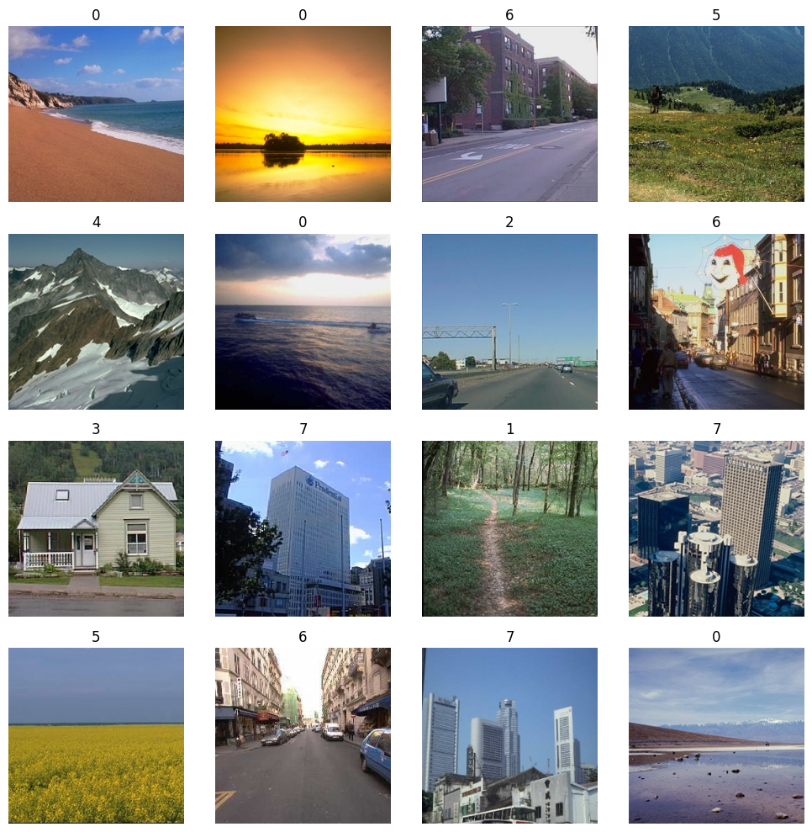
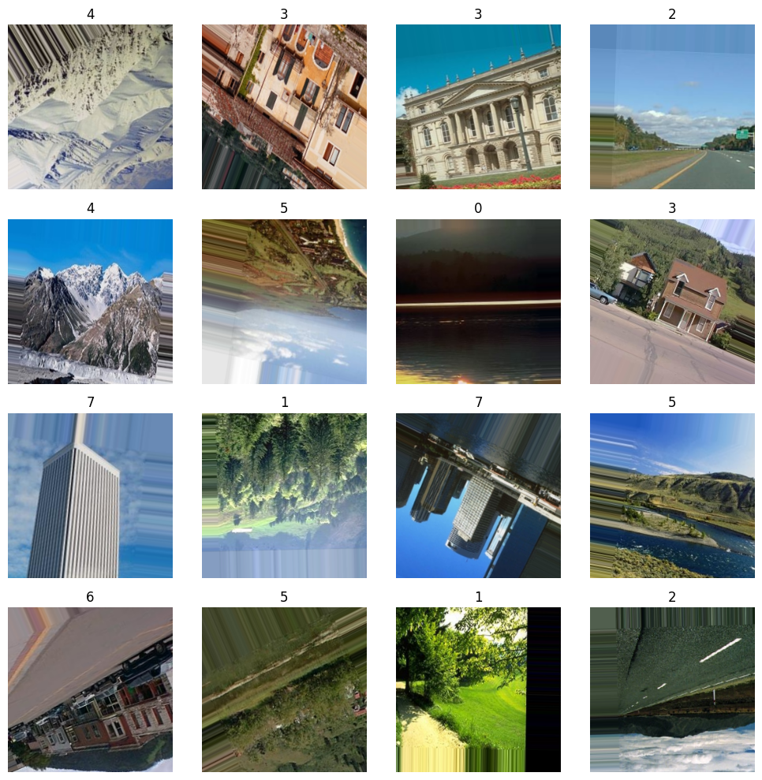
DATA
PREPROCESSING
Augmentation
Image augmentation introduces variations through transformations like rotation, scaling, and color adjustments, enhancing the model's generalization ability and robustness, even in a balanced dataset, by simulating diverse real-world scenarios.
Rotation Range = 30° (degrees)
Width Shift Range = 20% of total width
Height Shift Range = 20% of total height
Zoom Range = Up to 20% random zoom
Horizontal Flip = Enabled (random)
Vertical Flip = Enabled (random)
Fill Mode = 'Nearest' (for new pixels)
Normalization = Rescale by 1/255
Augmentation
Actual images
Augmented images

Slide 6
W
Pretrained models
Discussion
We have used several pre-trained models such as VGG16, MobileNetV2, ResNet50, EfficientNet, Vision Transformer (ViT), and DenseNet.
Every function sets up the matching pre-trained model for feature extraction or classification tasks by loading it with ImageNet weights. When the trainable layers of the models are set to non-trainable, users can either enhance the model to meet certain classification needs or extract features from the inner layers of the model. These pre-trained models' adaptability meets a variety of needs and provides a solid basis for effective transfer learning."
By using an SVM directly on the final layer of the MLP, we intend to test that the classifier's performance roughly matches with the features from the inner layers, emphasising the resilience and representational capacity of the learned hierarchical features.

Slide 7
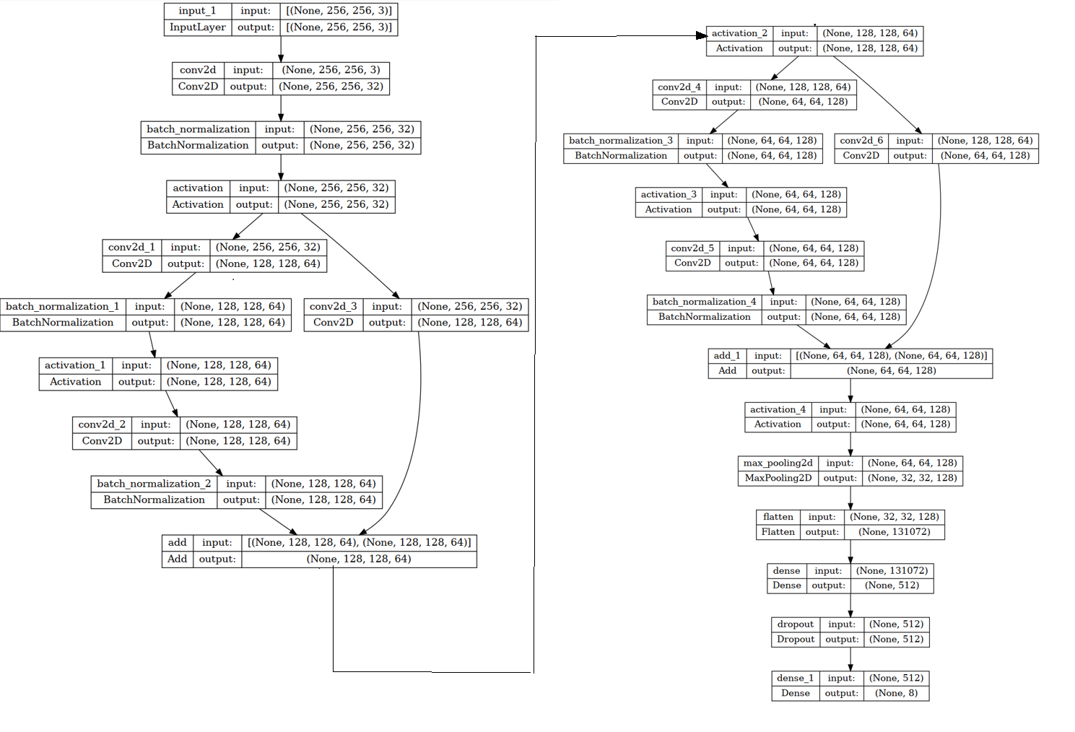
Own model
Proposed Residual CNN
Architecture

Slide 8
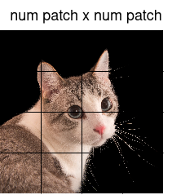
Model Explanation
Made from scratch
Layer Definition: The Conv2D layer performs a 2D convolution operation. In this example, it is part of a neural network that processes picture data.
Filters: The filter=64 argument specifies that this layer will generate 64 filters (or kernels). Each filter removes distinct characteristics from the input picture. For example, one filter may identify edges while another detects textures, and so forth.
Kernel Size: kernel_size=PATCH_SIZE sets the size of the window used to convolve over the picture. If PATCH_SIZE = 3, the kernel will be a 3x3 matrix. This size determines the degree of detail that the filter can capture.

Slide 9
Model Explanation
Made from scratch
Strides: strides=PATCH_SIZE sets the kernel's step size as it advances over the image. A stride equal to PATCH_SIZE indicates that the convolution operation's receptive fields do not overlap.
Activation Function: activation="relu" apply the Rectified Linear Unit (ReLU) activation function to the convolution output. This function adds nonlinearity to the model, enabling it to learn more complicated patterns.
Input Shape: input_shape=(IMG_SIZE, IMG_SIZE, IMG_CHANNEL) specifies the shape of the input data. This normally comprises the image's height and width (IMG_SIZE), as well as the number of colour channels.

Slide 10
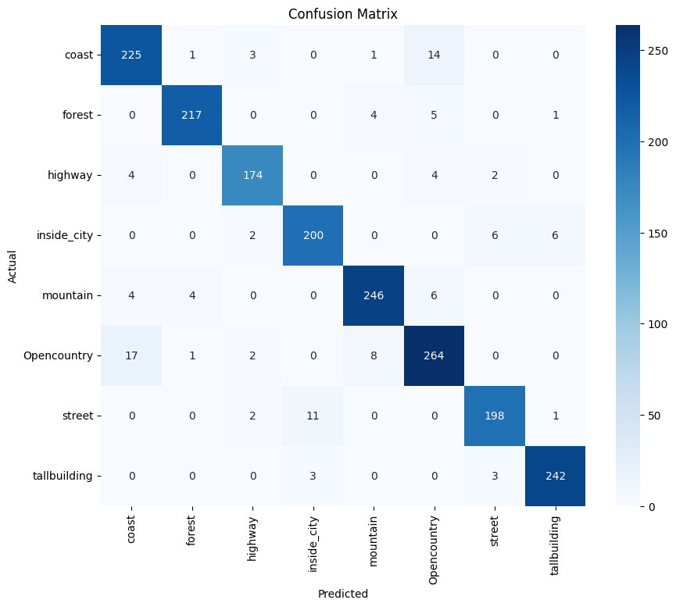
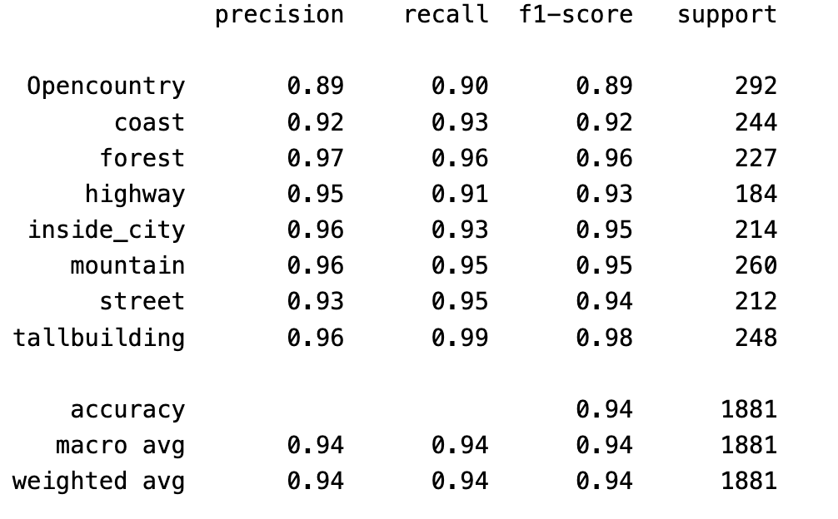
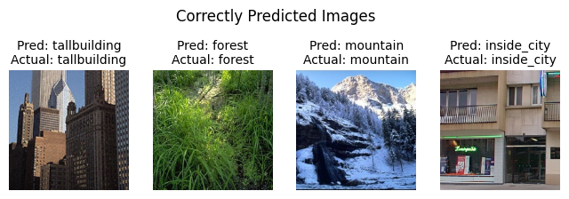
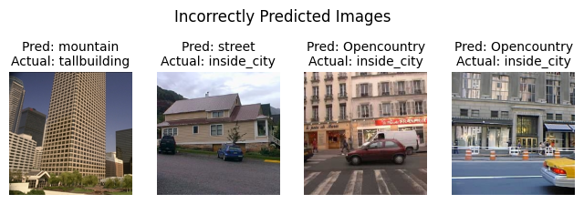
Model Performance
Test Evaluation

Slide 11
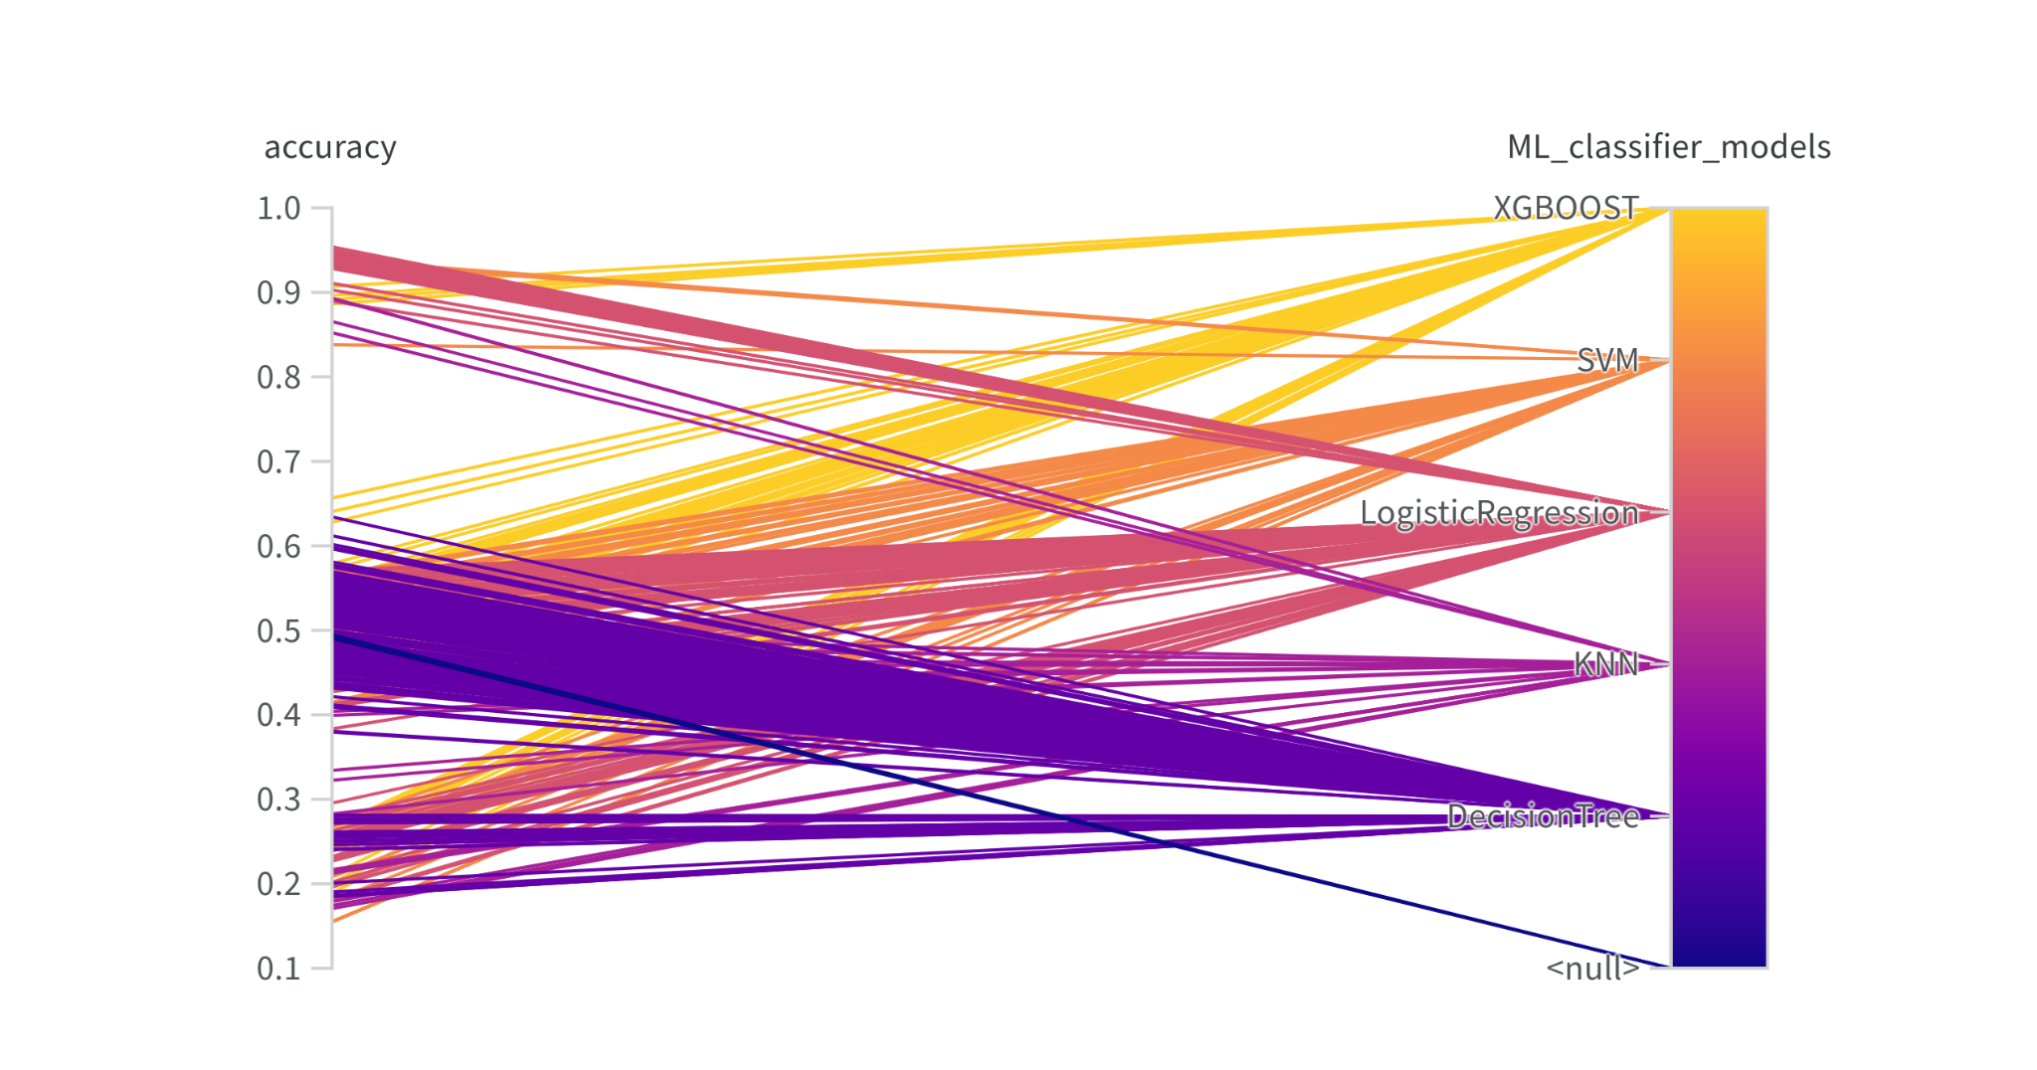
Accuracy
ML models
Logistic regression with CNN feature works best and test accuracy was 95.37%
XGBOOST also performed well with CNN features and best accuracy was 90.7%

Slide 12
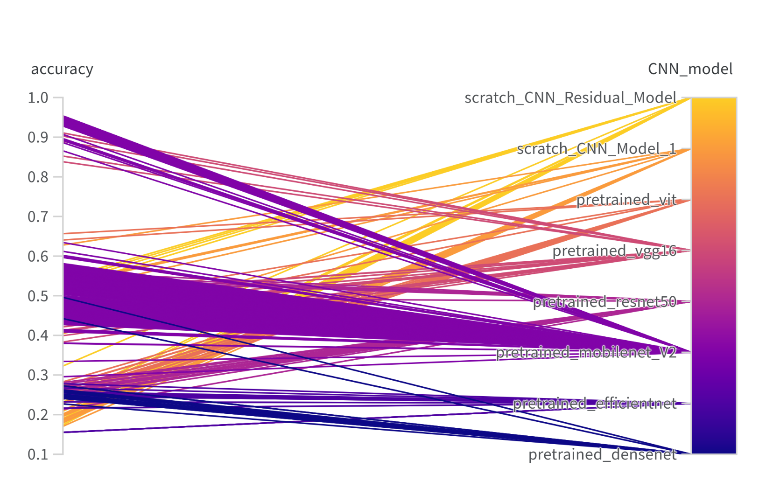
Accuracy
CNN models
Pretrained Mobile Net V2 was the best performing model with test accuracy of 95.37% and followed by VGG16 with 90.7% accuracy.
Our own proposed residual model achieved best test accuracy of 85.67%.

Slide 13
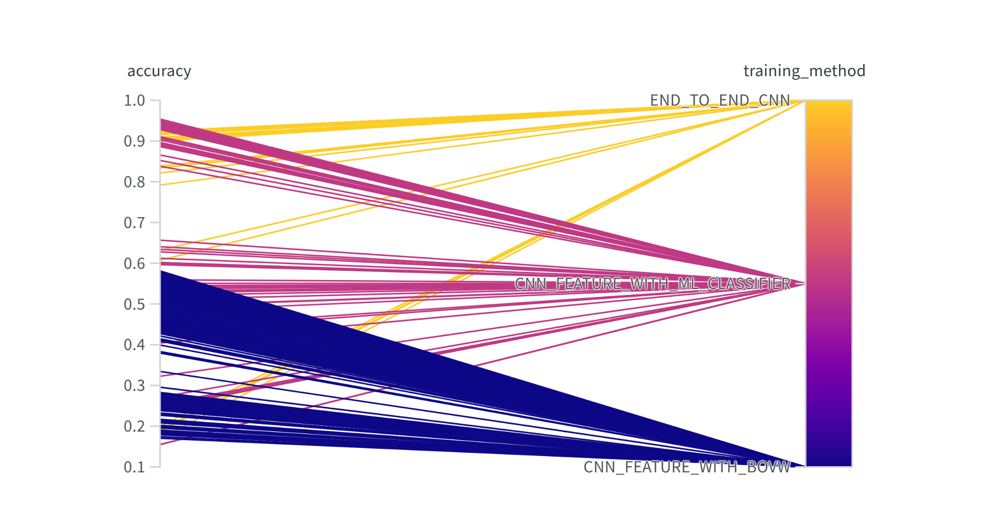
Accuracy
Training method
Approach to use CNN feature to train ML model outperforms other method and achieved best test accuracy of 95.37% followed by 92.07 % from proposed Residual CNN model and 57% from BOVW with CNN feature approach.

Slide 14
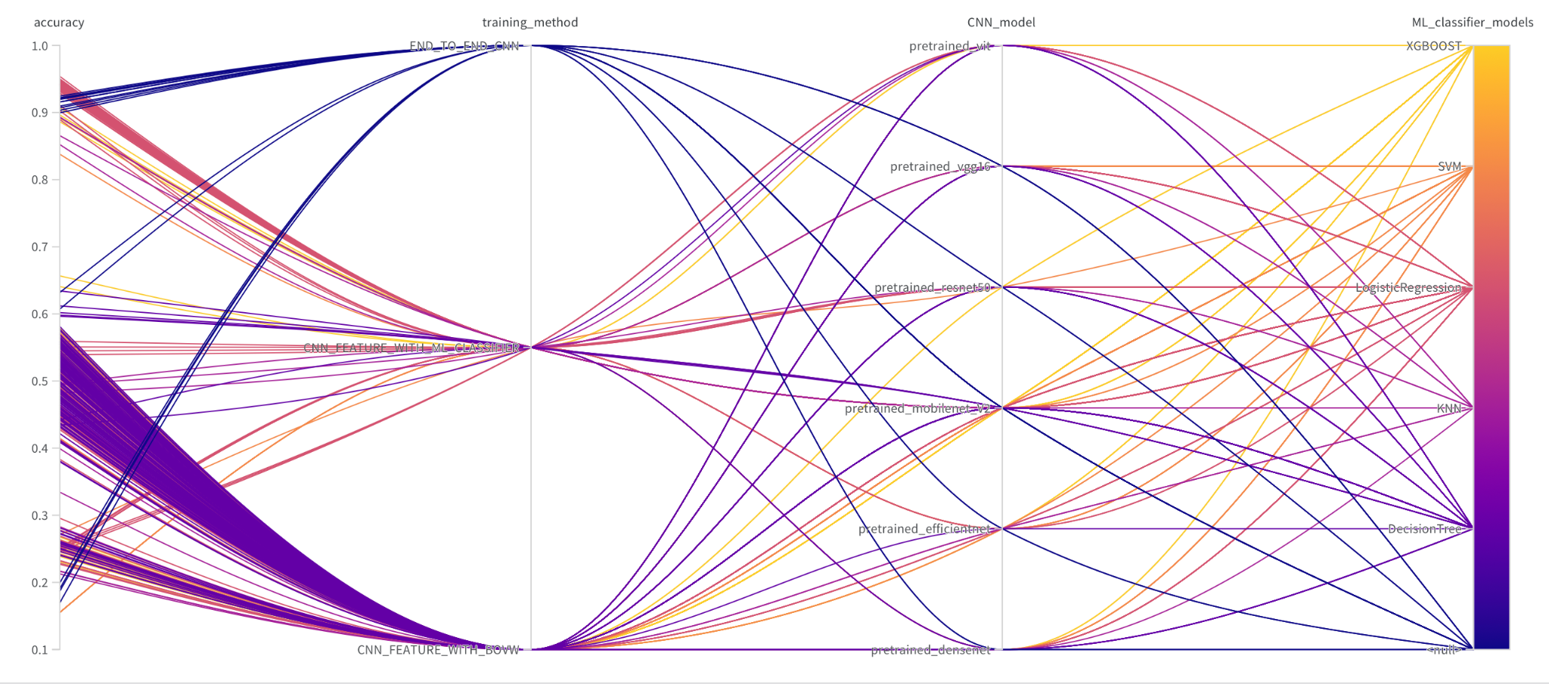
Model Performance
Test Evaluation
We have obtained 92.07% with own Residual CNN model
92% with dense net v2
95.3% with densenet feature and logistic regression classifier

Slide 15
Conclusions
Week2
For this week we can conclude that the end-to-end CNN attained an accuracy of 85.56%, DenseNet V2 performed well with 92%, and integrating DenseNet with an SVM classifier resulted in a significant accuracy increase to 95.3%. The accuracies of the pretrained models (VGG16, MobileNetV2, ResNet50, EfficientNet, Vision Transformer, DenseNet) were not specifically stated, however such models usually perform well due to their ability to learn hierarchical features.
Two of our own models, patched based CNN model and residual based CNN model, have accuracies of 85.56% and 92%, respectively. The residual based CNN model makes use of residual connections, demonstrating how such architectural decisions improve accuracy.

